Slide 1
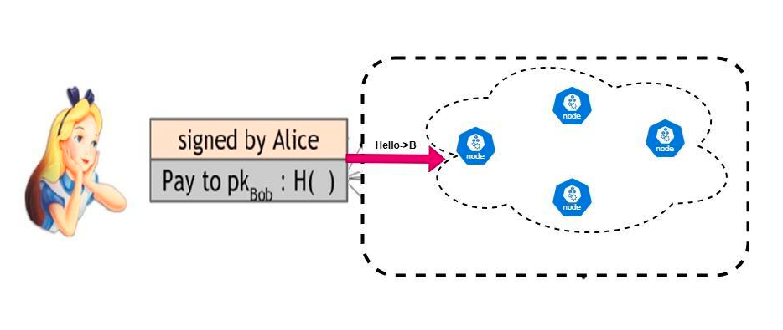
Task -1 Selection of Random Node
Key Points Nodes is implemented through thread code
Mechanism
1.POW Algorithm Run between
Decentralize Servers 1,2,3
Selected Random Node

